Slide 1
Design of dw & Bi
Healthcare organization
Name: X, Y, Z Prof. Joseph Morabito
Course: MIS 636, Spring 09 Date: 04/04/09

Slide 2
Healthcare Management issues
Challenges and Goals in Healthcare.
- The Right care
- To the Right patient
- At the Right time
- At the Right cost
Datawarehousing and BI provides measureable value in achieving these Goals.

Slide 3
Overview
High Level Design
  Candidate Subject Area
  Candidate Fact
  Bus Architecture
  Sequence of Construction
Development of Data Mart
Logical Dimension Model
  Star Schemas
  Grain
  Conformed Dimensions
Slowly Changing Dimensions
Transformation Rules
Aggregate Table
OLAP Cube
Role Specific BI Portal
Conclusion
References
  Objective
  Project Methodology
Key Findings/Results
  Results 1
  Results 2
Conclusion

Slide 4
Health Care Organization
Candidate Subject Areas
  Patient Admission ,
  Insurance Information validation ,
  Doctor-Patient Assignment,
  SF-36 Assessment,
  Vital signs check ,
  Patient Diagnosis,
  Therapy,
  Rehabilitation,
  Results reporting,
  Referral management,
  Utilization management,
  Pharmacy,
  Patient discharge,
  Insurance billing,
  Supplies purchase,
  Payroll ,
  Patient care quality
  Food services Management

Slide 5
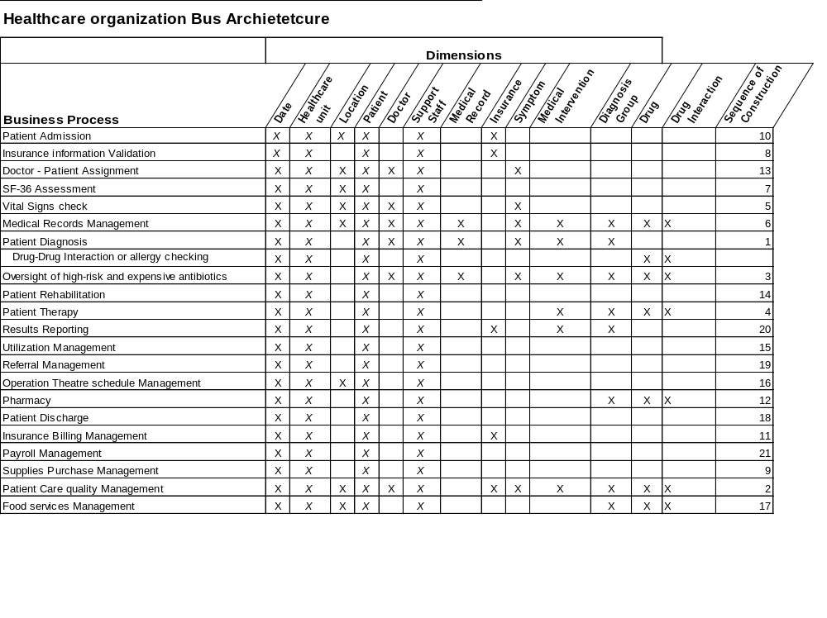
Health Care Organization
Bus Architecture

Slide 6
Point of Care Data Mart
Description of Point of Care Data Mart
  In Point of Care Data Mart, We focus on the diagnosis process which involves four stages, starting from Appointment, Assessment, Diagnosis Procedure and Prescription given by the doctor.
  To accomplish the above tasks, various factors (such as, Medical Records, Insurance Detail, Symptoms, Medical interventions, DRG codes) have been taken into consideration.

Slide 7
Point of Care Data Mart
  Association with other Data Mart:
      As we look into Bus Architecture Matrix, we can easily figure out that our Patient Diagnosis Business process, have same dimensions as,
        Patient Care Quality Management System, Medical Record Management, Antibiotics Risk Analysis, Patient Therapy, Pharmacy & Result Reporting.

Slide 8
Health Care Organization
Candidate Facts
The candidate facts which we have used to detail the
Point of Care business process are:
  Appointment Fact
  Assessment Fact
  Diagnosis Fact
  Prescription Fact

Slide 9
Health Care Organization
Sequence of construction
Patient Diagnosis
Patient Care quality management
Oversight of high risk and expensive antibiotics
Patient Therapy
Vital signs check
Medical records management
SF-36 assessment
…followed by others depicted in the bus architecture.

Slide 10
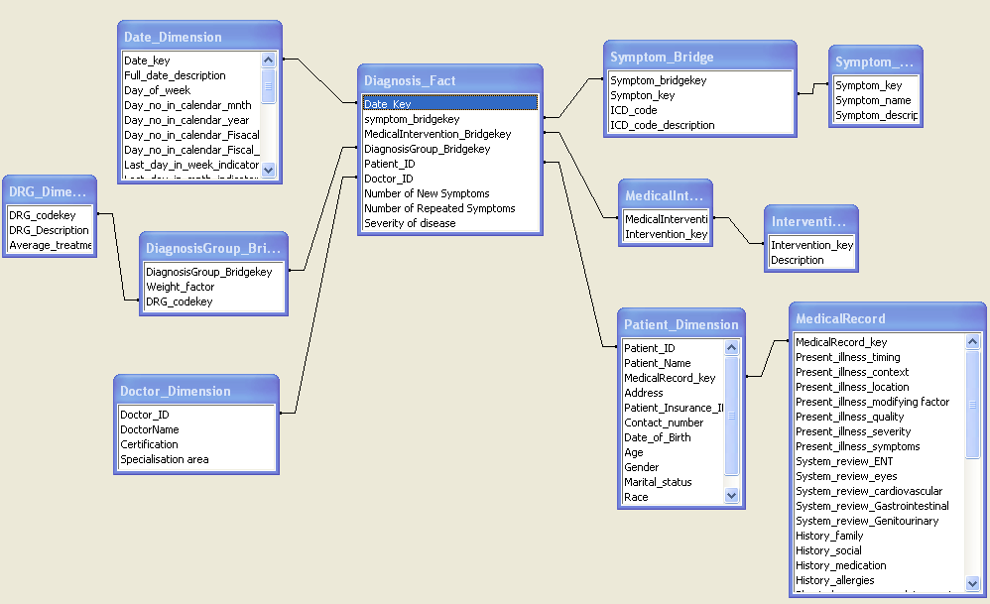
Logical Dimension Model
Point of Care Data Mart
Star Schema of Diagnosis

Slide 11
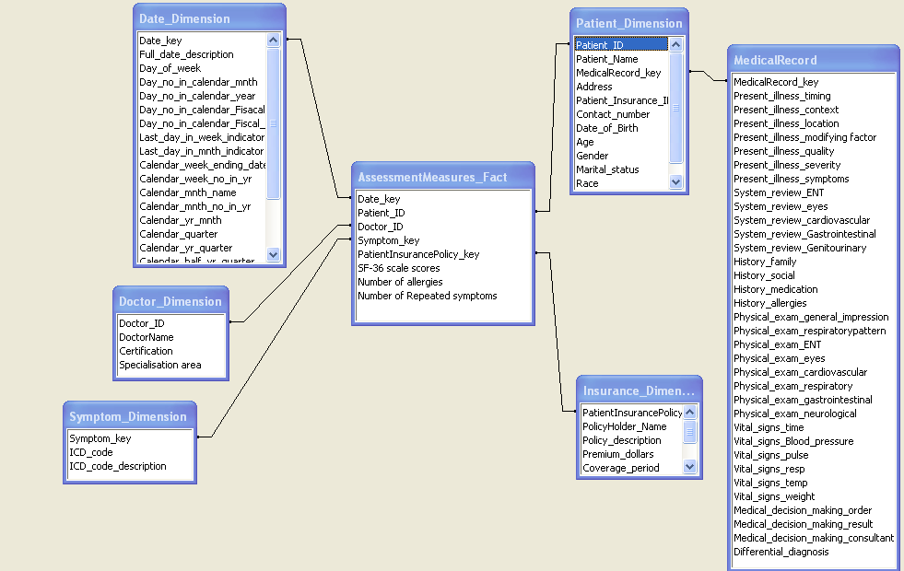
Logical Dimension Model
Point of Care Data Mart
Star Schema of Assessment Fact

Slide 12
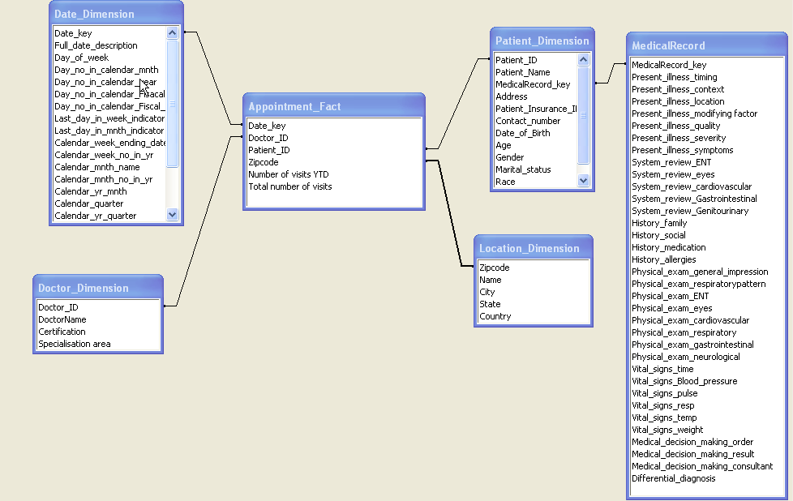
Logical Dimension Model
Point of Care Data Mart
Star Schema of Appointment

Slide 13
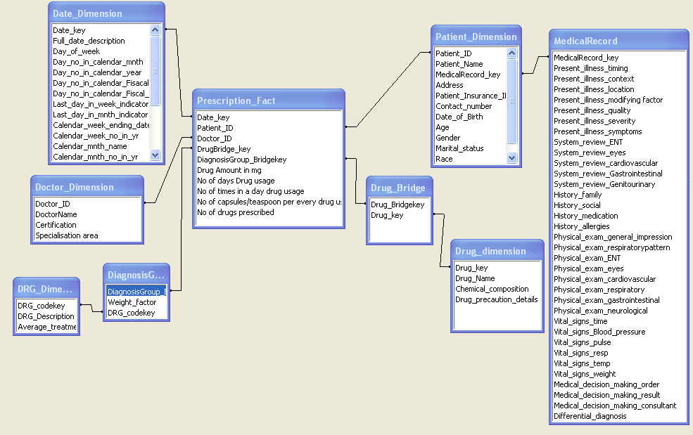
Logical Dimension Model
Point of Care Data Mart
Star Schema of Prescription

Slide 14
Logical Dimension Model
Point of Care Data Mart
Grain: Same as OLTP.
      ( Lowest possible level of detail).
      E.g. Row of Fact table “Prescription” will describe an individual patient’s prescription with drug, drug dosage and with usage direction given by doctor on particular date.
Additive, Semi-Additive, Non Additive Fact
  Prescription is Semi Additive Fact.
  Appointment is Additive Fact
  Diagnosis is Semi Additive Fact
  Assessment is Semi-Additive Fact

Slide 15
Conformed Dimensions
Point of Care Data Mart
Date Dimension
Health Care Unit Dimension
Patient Dimension
Support Staff Dimension
These are the dimension which are common among all business processes.

Slide 16
Slowly Changing Dimension
Example: Doctor Dimension
Change to track: “Certification” Attribute
Applied: Type 2
  Three Approaches for type 2:
    Version
    Flag
    Date
We select Date approach for “Certification” attribute.

Slide 17
Slowly Changing Dimension
Case1: Insert a new record if that that Doctor’s record doesn’t exist in DW.
  Action Needed: Add that Doctor Record in DW with
    Effective_from_date as Today’s Date
    Effective_to_Date as Infinity(NULL)
Case 2: Doctor Record is already exist in DW, but it is not the same as our source system. Means that, that particular doctor has updated certification
  Action needed:
    1. Update Existing record’s
      Effective_to_Date as Today’s Date from NULL
    Add new Record in DW with changed Certification value. Change its Effective_to_date as NULL & Effective_from_Date as Today’s Date

Slide 18
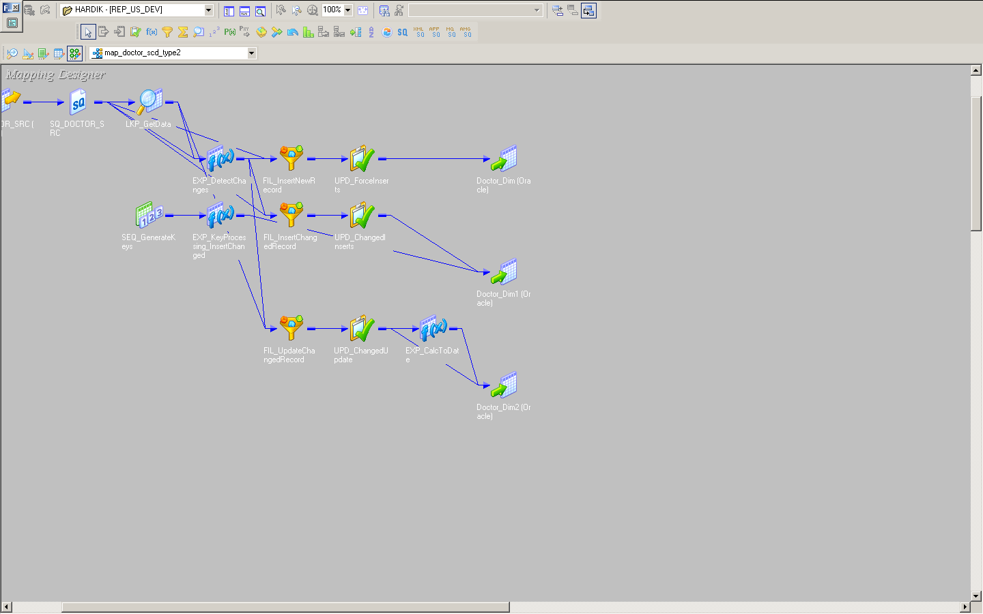
Slowly Changing Dimension

Slide 19
Transformation Rules
Rule Type | Description
Move | Source & Target contains same data value & Format
Transform | Source data values are converted to produce target data values. i.e. A will equal to B
Default | Source field doesn’t contain any values. In that case, put default value in Target table
Derive | Source field value is applied to a rule / arithmetic computation to create the target value. i.e. A*B=C
Drop | A field from Source is not carried over to the target field (to ensure that the given field was not forgotten)
Lookup | Use source field to access a populated table to determine if the value for the source field exists.

Slide 20
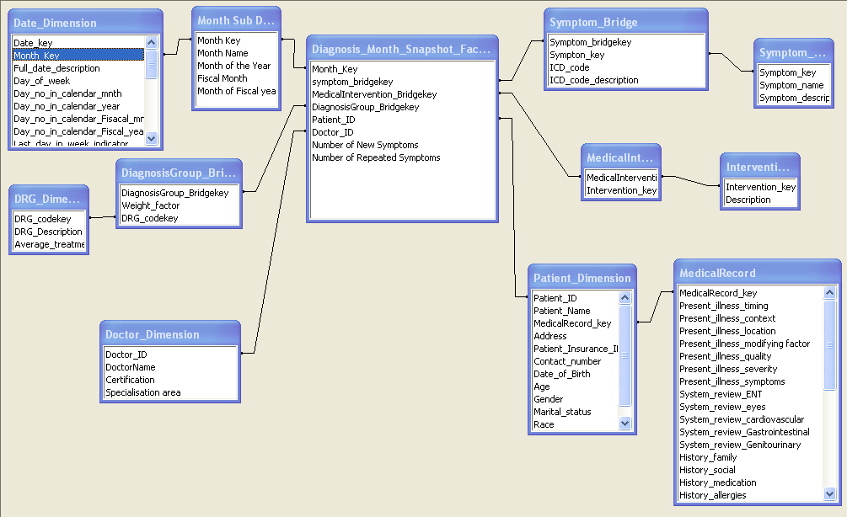
Aggregate Table
Notes:
Aggregated based on Month.
This is a pre-aggregated fact table, As we will need Monthly Report more frequently.
This will save our runtime calculation time on Reporting side.
This monthly fact will be calculated on Loading time at every month-ends.

Slide 21
OLAP CUBE
Sex
Tuber-
culosis
Fever
Diabetes
Arthritis
Asthama
Blood pressure
Age Group
Heart
Cold
Dense
Flu
Digestion
Alzehmiers
Migraine
Neurology
Oral health
Intestinal
Thyroid
Symptoms
Year-Month-Date
Age Group Range:
<1, 1- 4, 5-14, 15-24, 25-34, 35-44, 45-54, 55-64, 65-74, 75- 84, 85 and above.

Slide 22
Examples of Ad-Hoc Report Generation via various operations on the cube
Eg:1: Suppose you want to generate a report showing the diseases which have
affected the population in the age-group of 15-24 years for the year 2008.
Operations performed: Drill-down.
Explanation: For the above report generation, you would first select the
Appropriate year for which the report is to be generated i.e year 2008.
Secondly, since there are various ranges for the age-group, you would
Adopt a drill-down approach to get to the age group of 15-24 years
And a report would be generated showing the details of the diseases which
Have affected the age-goup of 15-24 for the year 2008.

Slide 23
Examples of Ad-Hoc Report Generation via various operations on the cube
Eg:2: Suppose you want to generate a report showing the diseases and the
associated symptoms with those diseases which have affected the population
in the age-group of 15-24 years for the month of December In the year 2008.
Operations performed: Drill-down and slicing.
Explanation: For the above report generation, you would first select the
Appropriate year for which the report is to be generated i.e year 2008 and
Then drill-down to select the appropriate month i.e December.
Secondly, since there are various ranges for the age-group, you would
Adopt a drill-down approach to get to the age group of 15-24 years
Now to have the symptoms displayed in the report you would have to
Perform a slicing operation with respect to Symptoms ,age group,
And Year-Month-date for that particular disease.

Slide 24
Examples of Ad-Hoc Report Generation via various operations on the cube
Eg:3: Suppose you want to generate a report to analyze which population
With respect to sex has been majorly affected by Diabetes.
Operation :Slicing
Explanation: For the above report generation, you would just need to perform the
Slicing operation across the sex dimension for that particular disease which is
Diabetes.

Slide 25
Role Specific BI Portal
Type of User:
  Power Users: Total Quality Care Managers
    They are the stakeholders, who needs complete access on DW to derive values like Patient Satisfaction, Patient Loyalty, Patient experience Measures, Clinical effectiveness, Diagnosis Success Ratio, Disease Trend etc.
    E.g. Output Needs: Complete Ad-Hoc Analysis of Patient Care fact.
  Executives: Hospital facility Management, Hazard and Risk Analysis specialists.
    E.g. Needs monthly report on various data sources like, Appointment, Diagnosis, Symptoms etc.
  Operational Workers: Support Staff
    E.g. Operation Theater Schedule Report, Patient Pre-Operation report, Doctor Schedule Reports etc.

Slide 26
Role Specific BI Portal
Access methods:
Users | Type of Access
Doctor | Ad-Hoc Report
Patient | Parameterized Report
Hospital Managers | OLAP Cube Slice
Quality Care Managers | A full Cube
Risk Analyst | A full Cube
Support Staff | Standard Report

Slide 27
Conclusion
Conclusion:
The part of “Point of care” Data-warehouse which we have build based
On the candidate facts such as Appointment , Diagnosis, Assessment and
Prescription would provide easy access to potential users right from Doctor,
Patient , Hospital Managers, Quality care Managers , Risk Analysts to the
Support staff to do analysis and make appropriate decisions to provide
Value in Healthcare.
- The Right care
- To the Right patient
- At the Right time

Slide 28
References
1.”How business intelligence is making healthcare smarter” Vawn Himmelsbach
2.”Signs of Intelligent Life.”
Computing Canada. 31(8), 2005
3. “A Framework for Designing a Healthcare Outcome Data Warehouse.”
by Bambang Parmanto PhD,1,2 Matthew Scotch,2 and Sjarif Ahmad1
4. “Performance Improvement Through Information Management: Health Care's Bridge to Success”
By Marion J. Ball, Judith V. Douglas
5. “Point-of Care of- Clinical Systems”, NSW Health
Dianne Ayres MInfoCommTech., BAdmin (Nurs)., RN.,RM
6. “Learning Healthcare System Concepts v2008”
Institute of Medicine of the National Academics
6. “Datawarehouse_toolkit_Ralph_Kimball.”
Edition 1
7. “The relevance of data warehousing and data mining in the field of evidence-based medicine to support healthcare decision making.”
Nevena Stolba and A Min Tjoa

